Slide 1
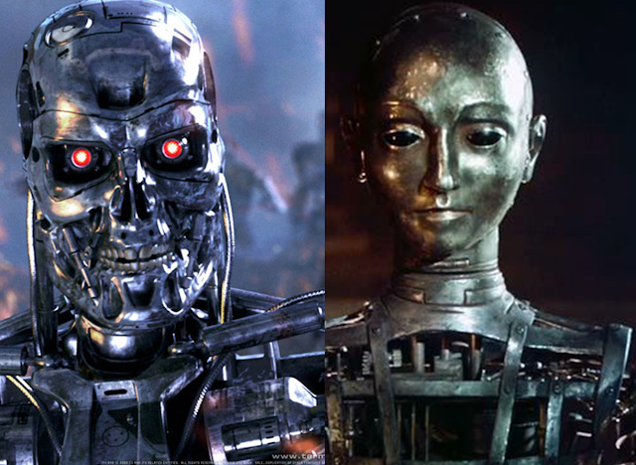
Theory Of Automata
<number>
Notes:
<number>

Slide 2
Lecture # ….
Theory of Automata
2

Slide 3
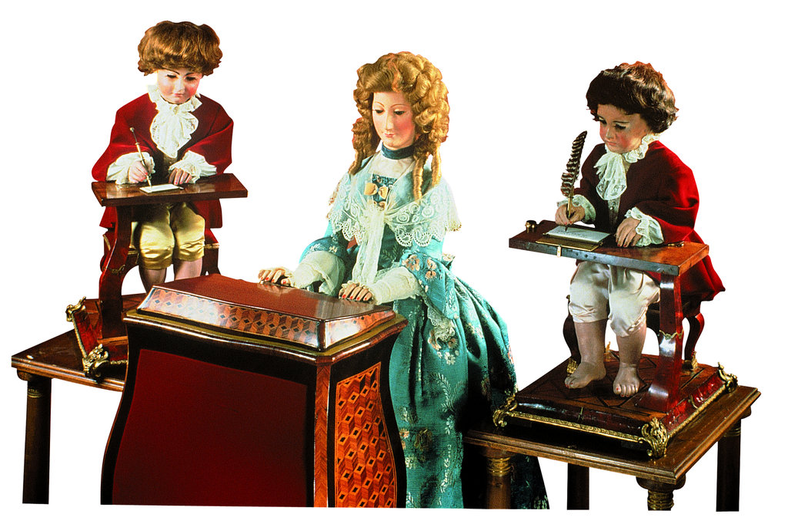
Recall…….
What is Automata?
It is the plural of automaton, and it means “something that works automatically”.
<number>

Slide 4
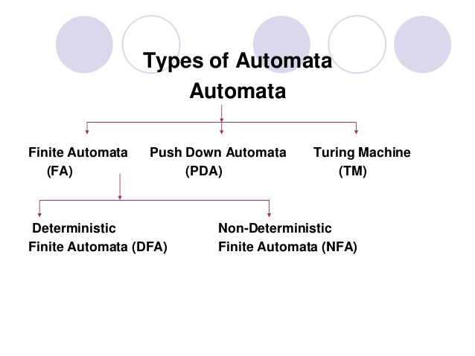
<number>

Slide 5
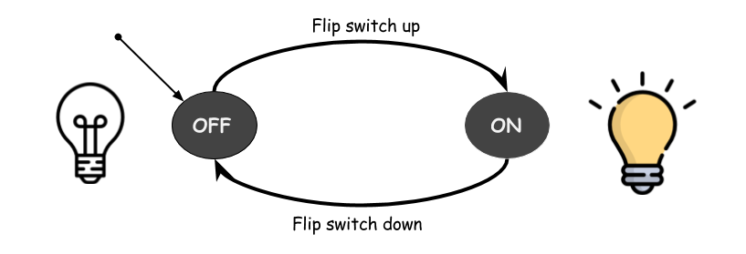
FINITE AUTOMATA
5

Slide 6
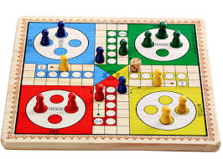
Finite Automata
A language defining method
Also known as Finite State Machine (FSM), Finite State Automata (FSA) ,State Machines.
It is just like a ludo in which token changes position on the input if certain number of dice
<number>

Slide 7
Finite Automata
A FA is defined as follows:-
Finite number of states in which one state must be initial state and more than one or may be none can be the final states.
Sigma Σ provides the input letters from which input strings can be formed.
FA Distinguishing Rule: For each state, there must be an out going transition for each input letter in Sigma Σ.
<number>

Slide 8
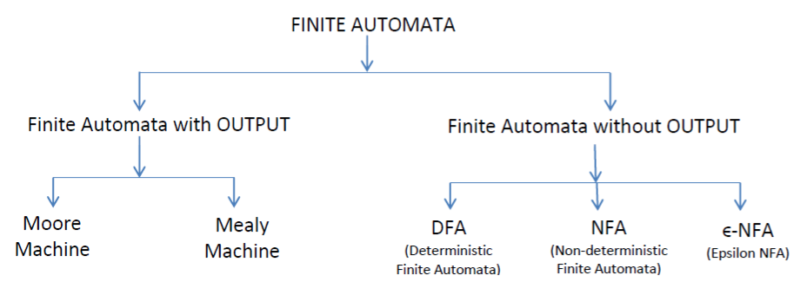
Types of Finite Automata
<number>

Slide 9
DETERMINISTIC FINITE AUTOMATA
9

Slide 10
1:Deterministic Finite Automata
It represents an abstract machine which is used to represent a regular language
A regular expression can also be represented using Finite Automata
There are two ways to specify an FA:
1) Transition Tables and
2) Directed Graphs.
9

Slide 11
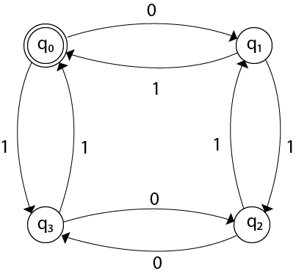
Graphical Representation
Each node (or vertex) represents a state, and the edges (or arcs) connecting the nodes represent the corresponding transitions.
Each state can be labeled
11

Slide 12
DFA consists of 5 tuples {Q, ∑, q, F, δ}.
Q : set of all states.
∑ : set of input symbols. ( Symbols which machine takes as input )
q : Initial state. ( Starting state of a machine )
F : set of final state.
δ : Transition Function,
defined as δ : Q X ∑ --> Q.
<number>

Slide 13
For a particular input character, the machine goes to one state only.
Null (or ε) move is not allowed.
DFA cannot change state without any input character.
Question: Why FA is said to Finite Automata?
<number>

Slide 14
Transition Table
The indicates the start state: here q0
The * indicates the final state(s) (here only one final state q1)
STATE | INPUT 0 | INPUT 1
q0 | q1 | q0
q1 | q1 | q2
* q2 | q2 | q2
14

Slide 15
This defines the following transition diagram
0 1
1 0 0,1
q0
q1
q2
<number>

Slide 16
Examples
1: Construct a DFA for a language L = {aa}
∑ = {a}
L ={aa} (Language with only one string aa)
a a a
D= Dead State a
q0
q1
D
q2
16

Slide 17
2: Construct a DFA for a language L = {aba}
∑ = {a,b}
L ={aba} (Language with only one string aba)
Here ,q4 = Dead state
a
a b a
b
b a,b
a,b
a,b
q0
q1
q2
q3
q4
17

Slide 18
3: Construct a DFA with ∑ = {0, 1} accepts all strings starts with 0.
Also construct a Transition Table for the this DFA
Hint: First make the language for the above DFA.
18

Slide 19
Construct a DFA with ∑ = {0, 1} accepts all strings starts with 0.
L = {0,00,01,001,011,……..}
0,1
0
1
0,1
q0
q1
q2
19

Slide 20
Here
q0 is initial or start state
On getting 0 input it goes to q1
On getting 1 input it goes to q2
q1 is the final state having self loop (having all combinations of 0 and 1 strings)
The state q2 is the Dead State or Trap state.
Dead State: The strings are trapped in this state and will not reach the final state and hence not acceptable by DFA
The strings which reaches the final state will only be accepted by DFA.
20

Slide 21
4: Construct a DFA with ∑ = {0, 1} accepts all strings ending with 0.
20

Slide 22
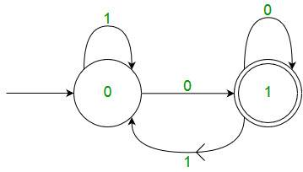
Construct a DFA with ∑ = {0, 1} accepts all strings ending with 0.
L= {0,00,10,000,100,110,0000,…….}
Construct a Transition Table for the above DFA
22

Slide 23
5:Construct a DFA that accepts set of all strings over {0, 1} of length 2 .
Also define 5 tuples for it .
<number>

Slide 24
∑ = {0, 1}
L ={00,01,10,11}
0,1 0,1
0,1
0,1
q0
q1
q2
q2
24

Slide 25
6: Construct a DFA that accepts set of all strings ending with 100
<number>

Slide 26
∑ = {0, 1}
L ={100,0100,1100,01100,……..}
1
1 0 0
0 1
0, 1
q0
q1
q2
q3
26

Slide 27
Designing Finite Automata from Regular Expression
1: Construct a DFA for R.E. = ab(a+b)*
(Hint: make strings (language) for the mentioned R.E).
Solution:
∑={a,b}
L= {ab,aba,abb,abaa,abab,abba,abbb,….}
<number>

Slide 28
Construct a DFA for R.E. = ab(a+b)*
a b
a,b
a
b a,b
q0
q1
q2
q3
27

Slide 29

Don’t forget to draw Transition Table and mention 5 tuples for the all of these examples.
<number>

Slide 30
2:Draw a DFA for the language accepting strings starting with ‘a’ over alphabets {a,b}
<number>

Slide 31
2:Draw a DFA for the language accepting strings starting with ‘a’ over alphabets {a,b}
Solution:
∑ = {a,b}
Regular Expression for the language will be
a(a+b)*
L= {a,aa,ab,aaa,aab,aba,abb,…….}
<number>

Slide 32
The required DFA is :
a,b
a
b
a,b
q0
q1
D
<number>

Slide 33
3:Construct a DFA for a regular expression
101(0+1)*
Solution:
∑ = {0,1}
L = {101,1010,1011,10100,10101,10110,10111,…………}
<number>

Slide 34
0,1
1 0 1
0 1 0
0,1
q0
q1
q2
q3
D
34

Slide 35
4: Draw a DFA that accepts a language L over input alphabets {0,1} such that L is the set of all the string starting with 00.
<number>

Slide 36
Solution:
∑ = {0,1}
Regular Expression for the language will be
00(0+1)*
L= {00,000,001,0000,0001,0010,0011,…….}
<number>

Slide 37
0,1
0 0
1
1
0,1
q0
q1
q2
D
<number>

Slide 38
5: Construct a DFA that accepts a language L over imput alphabets {a,b} such that L is the set of all string starting with aa or bb.
<number>

Slide 39
Solution:
∑ = {a,b}
Regular Expression for the language will be
(aa+bb)(a+b)*
L= {aa,bb,aaa,aab,bba,bba,……..}
<number>

